Slide 1


Vasilios Philippou
10/4/2021

Slide 2

Outline
Executive Summary
Introduction
Methodology
Results
Conclusion

Slide 3
Executive Summary
Summary Of Methodologies
Data Collection
Data Wrangling
EDA with Data Visualization
EDA with SQL
Interactive Map with Folium
Predictive Analysis (Classification)
Summary Of All Results
Exploratory Data Analysis Results
Interactive Analytics Demo in Screenshots
Predictive Analytics Results

Slide 4
INTRODUCTION
Project Background and Context
We predicted if the Falcon 9 first stage will land successfully. SpaceX advertises Falcon 9 rocket launches on its website, with a cost of 62 million dollars, when other providers cost upward of 165 millions dollars each, much of the saving is because SpaceX can reuse the first stage. Therefore, if we can determine if the first stage will land, we can determine the cost of the launch. This information can be used if an alternate company wants to bid against SpaceX for a rocket launch
Common problems that needed solving
What influences if the rocket will land successfully
The effect each relationship with certain rocket variables will impact in determining the success rate of a successful landing
What conditions does SpaceX have to achieve to get the best results and ensure the best rocket success landing rate.

Slide 5
Methodology
Data Collection Methodology:
SpaceX Rest API
Web Scraping
- Performed Data Wrangling ( Transforming Data for ML)
- One Hot Encoding data fields for Machine Learning and dropping irrelevant columns
- Performed exploratory Data Analysis (EDA) using visualization and SQL
- Plotting: Scatter Graphs, Bar Graphs to show relationships between variables and show patterns of data
- Performed interactive visual analytics using Follium and Plotly Dash
- Performed predictive analysis using classification models
- How to build, tune and evaluate classification models

Slide 6
Data Collection
The following Data Set was collected by:
- We worked with SpaceX launch data that is gathered from the SpaceX Rest API.
- This API will give us data about launches, including information about the rocket used, payload delivered, launch specifications, landing specifications, and landing outcome
- Our goal is to use this data to predict whether SpaceX will attempt to land a rocket or not
- The SpaceX REST API endpoints, or URL, starts with api.spacexdata.com/v4/.
- Another popular data source for the obtaining Flacon 9 Launch data is web scraping Wikipedia using BeautifulSoup

Slide 7
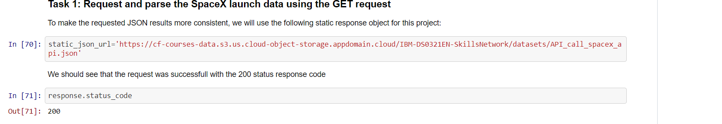
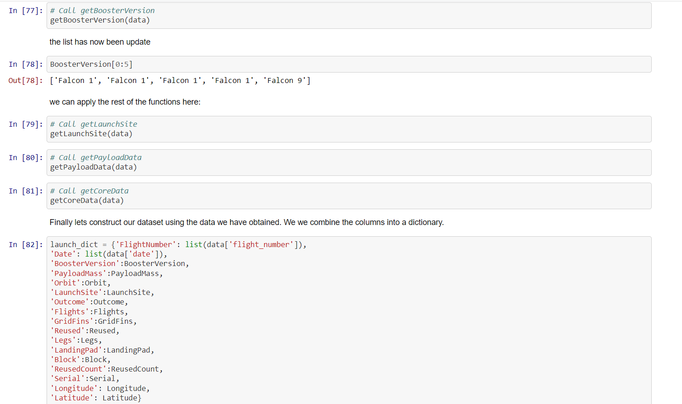
Data Collection- SpaceX API https://github.com/VasiliosPhilippou/IBM-Data-Science/blob/main/Capstone%20IBM%20Project.ipynb
Getting Response from API
2) Apply custom function to clean data/ Assign list to dictionary then dataframe

Slide 8
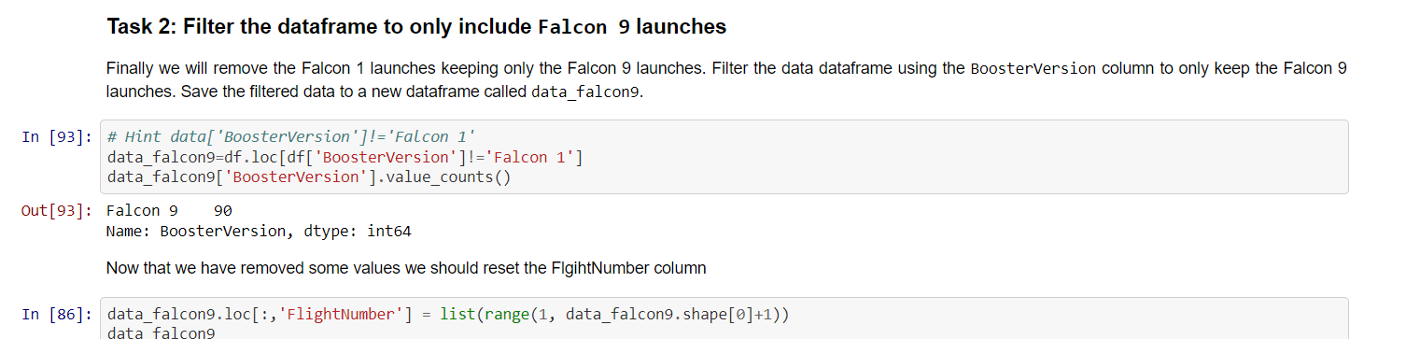
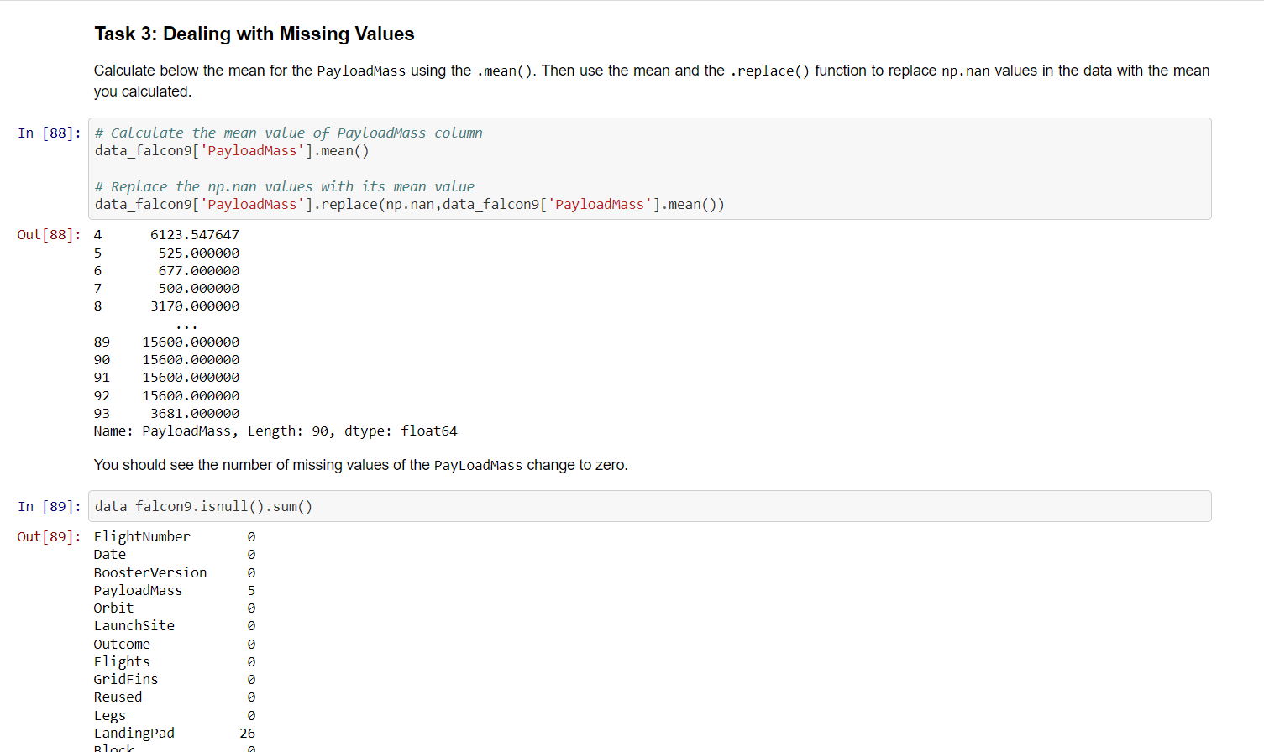
3) Filter Data Frame and export to flat file (.csv)
Data Collection- SpaceX API https://github.com/VasiliosPhilippou/IBM-Data-Science/blob/main/Capstone%20IBM%20Project.ipynb
4) Dealing with missing values

Slide 9
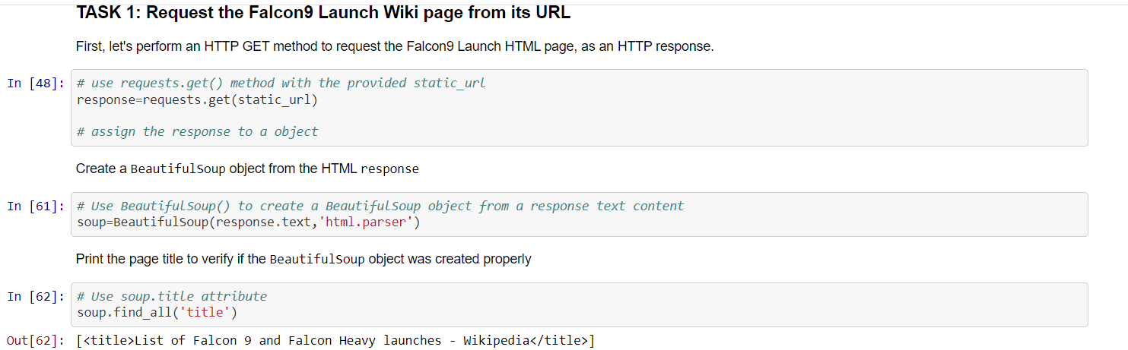
1) Request the Falcon9 Launch Wiki page from its URL
Data Collection- Web Scrapping https://github.com/VasiliosPhilippou/IBM-Data-Science/blob/main/CAP%20IBM%20-%20WEB%20SCRABLING.ipynb

Slide 10
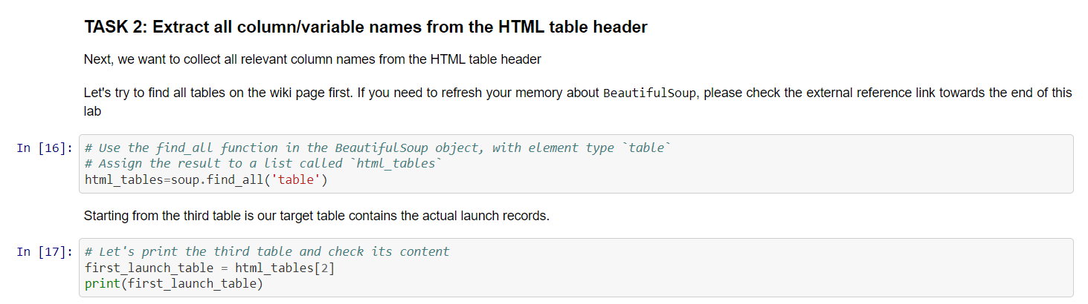
2) Extract all column / variable names from the HTML table header
Data Collection- Web Scrapping https://github.com/VasiliosPhilippou/IBM-Data-Science/blob/main/CAP%20IBM%20-%20WEB%20SCRABLING.ipynb

Slide 11
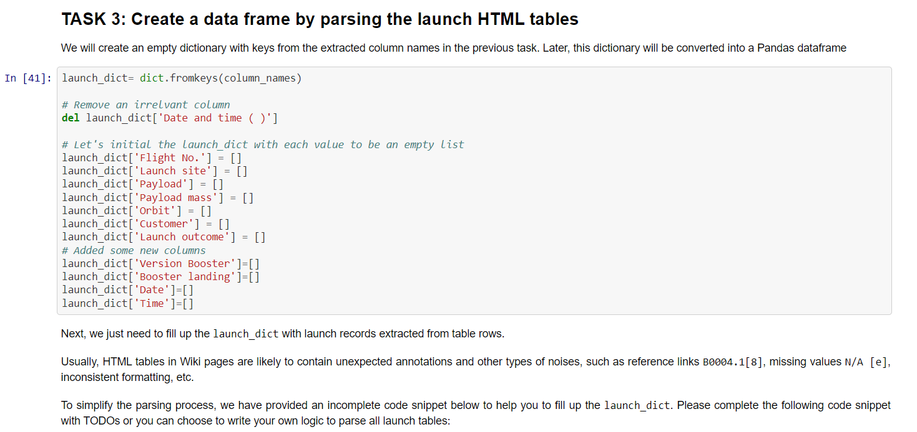
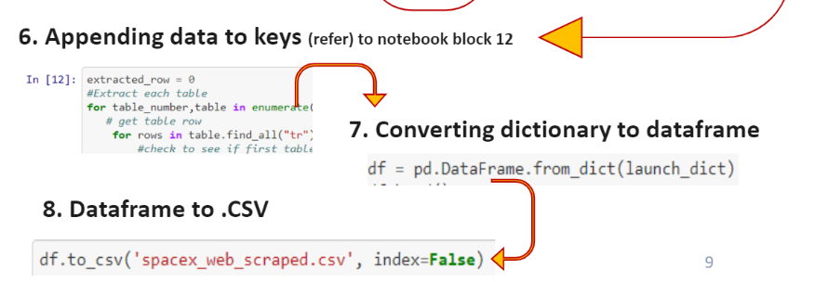
3) Create a data frame parsing the launch HTML tables
Data Collection- Web Scrapping https://github.com/VasiliosPhilippou/IBM-Data-Science/blob/main/CAP%20IBM%20-%20WEB%20SCRABLING.ipynb

Slide 12
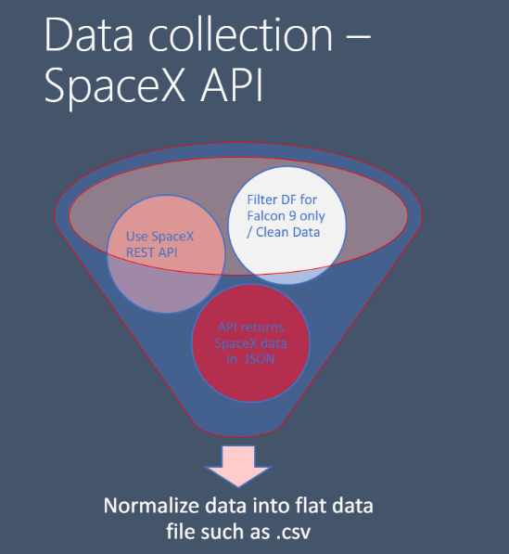
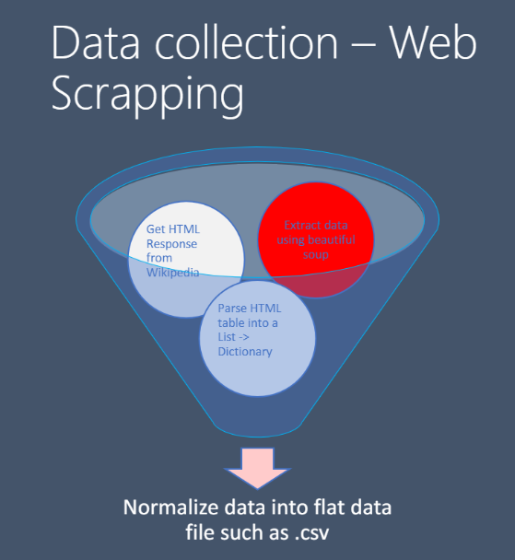

Slide 13
In the data set, there are several different cases where the booster did not land successfully. Sometimes a landing was attempted but failed due to an accident; for example, True Ocean means the mission outcome was successfully landed to specific region of the ocean while False Ocean means the mission outcome was unsuccessfully landed to a specific region of the ocean. True RTLS means the mission outcome was successfully landed to a ground pad, False RTLS means the mission outcome was unsuccessfully landed to a ground pad. True ASDS means the mission outcome was successfully landed on a drone ship and False ASDS means the mission outcome was unsuccessfully landed on a drone ship.
We mainly convert those outcomes into Training Labels with 1 means the booster successfully landed and 0 means it was unsuccessful.
Data Wrangling

Slide 14
Data Wrangling https://github.com/VasiliosPhilippou/IBM-Data-Science/blob/main/CAP%20IBM%20-%20DATA%20WRANGLING%20EDA.ipynb
Phases :
-Perform Exploratory Data Analysis EDA on dataset
-Calculate number of launches at each site
-Calculate number and occurrence of each orbit
-Calculate the number/occurrence of mission outcome per orbit type
-Export data set as .CSV
-Create a landing outcome label from Outcome column
-Work out success rate for every landing dataset

Slide 15
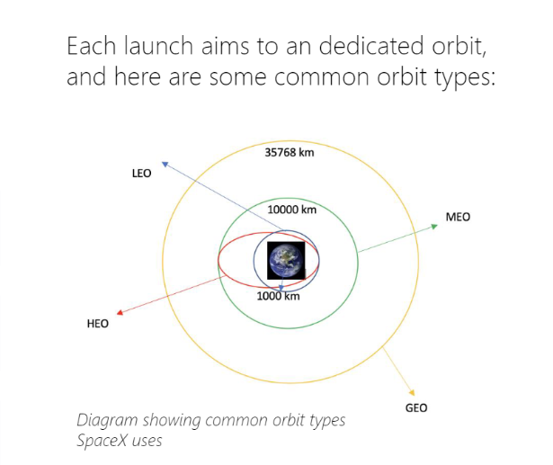
Data Wrangling https://github.com/VasiliosPhilippou/IBM-Data-Science/blob/main/CAP%20IBM%20-%20DATA%20WRANGLING%20EDA.ipynb

Slide 16
Scatter Graphs :
-Flight Number VS. Payload Mass
-Flight Number VS. Launch Site
-Payload VS. Launch Site
-Orbit VS. Flight Number
-Payload VS. Orbit Type
Orbit VS. Payload MASS
Scatter plots show how much one variable is affected be another. The relationship between two variables is called correlation. Scatterplots usually consist of a large body of data, but they don’t explain causation between the two variables
EDA with Visualization https://github.com/VasiliosPhilippou/IBM-Data-Science/blob/main/CAP%20IBM%20-%20EDA%20WITH%20DATA%20VISUALIZATION.ipynb

Slide 17
EDA with Visualization https://github.com/VasiliosPhilippou/IBM-Data-Science/blob/main/CAP%20IBM%20-%20EDA%20WITH%20DATA%20VISUALIZATION.ipynb
Bar Graphs :
Mean VS. Orbit
A bar diagram makes it easy to compare sets of data between different groups at a glance. The graph represents categories on one axis and a discrete value in the other. The goal is to show the relationship between the two axes. Bar charts can also show big changes in data over time
Line Graph :
Success Rate VS. Year
Line graphs are useful in that they show data variables and trends very clearly and can help to make predictions about the results of data not yet recorded

Slide 18
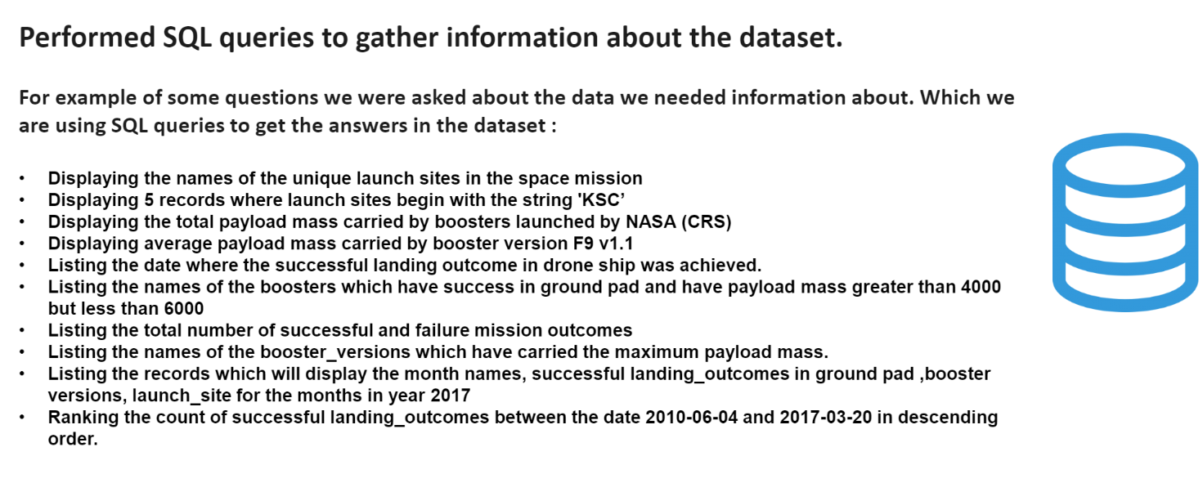
EDA with SQL https://github.com/VasiliosPhilippou/IBM-Data-Science/blob/main/CAP%20IBM%20-%20EDA%20WITH%20SQL.ipynb

Slide 19
Building an interactive Map with Folium https://github.com/VasiliosPhilippou/IBM-Data-Science/blob/main/CAP%20IBM%20-%20DASHBOARDS%20(1).ipynb
To visualize the Launch Data into an inter active map. We took the Latitude and Longitude Coordinates at each launch site and added a Circle Marker around each launch site with a label of the name of the launch site.
We assigned the dataframe launch_outcomes(failures, successes) to classes 0 and 1 with Green and Red markers on the map in a MarkerCluster()
Using Haversine’s formula we calculated the distance from the Launch Site to various landmarks to find various trends about what is around the Launch Site to measure patterns. Lines are drawn on the map to measure distance to landmarks
Example of some trends in which the Launch Site is situated in.
- Are launch sites in close proximity to railways? No.
- Are Launch sites in close proximity to highways? No.
- Are Launch sites in close proximity to coastline? Yes.
-Do launch sites keep certain distance away from cities? Yes.

Slide 20
Predictive Analysis with Classification https://github.com/VasiliosPhilippou/IBM-Data-Science/blob/main/CAP%20IBM%20-%20CLASSIFICATION.ipynb
Building Model
- Loading our dataset into NumPy and Pandas
- Transform Data
- Split our data into training and test data
Check how many test samples we have
Decide which type of machine learning algorithms we want to use
Set our parameters and algorithms to GridSearchCV
Fit our datasets into the GridSearch objects and train our data
Evaluating Model
- Check accuracy for each model
- Get tuned hyperparameters for each type of algorithm
- Plot Confusion Matrix
Improving Model
- Feature Engineering
- Algorithm Tuning
Find the best predicting Classification Model

Slide 21

Results
Exploratory Data Analysis
Interactive Analysis Demo in Screenshots
Predictive Analysis Results

Slide 22

EDA WITH VISUALIZATION

Slide 23
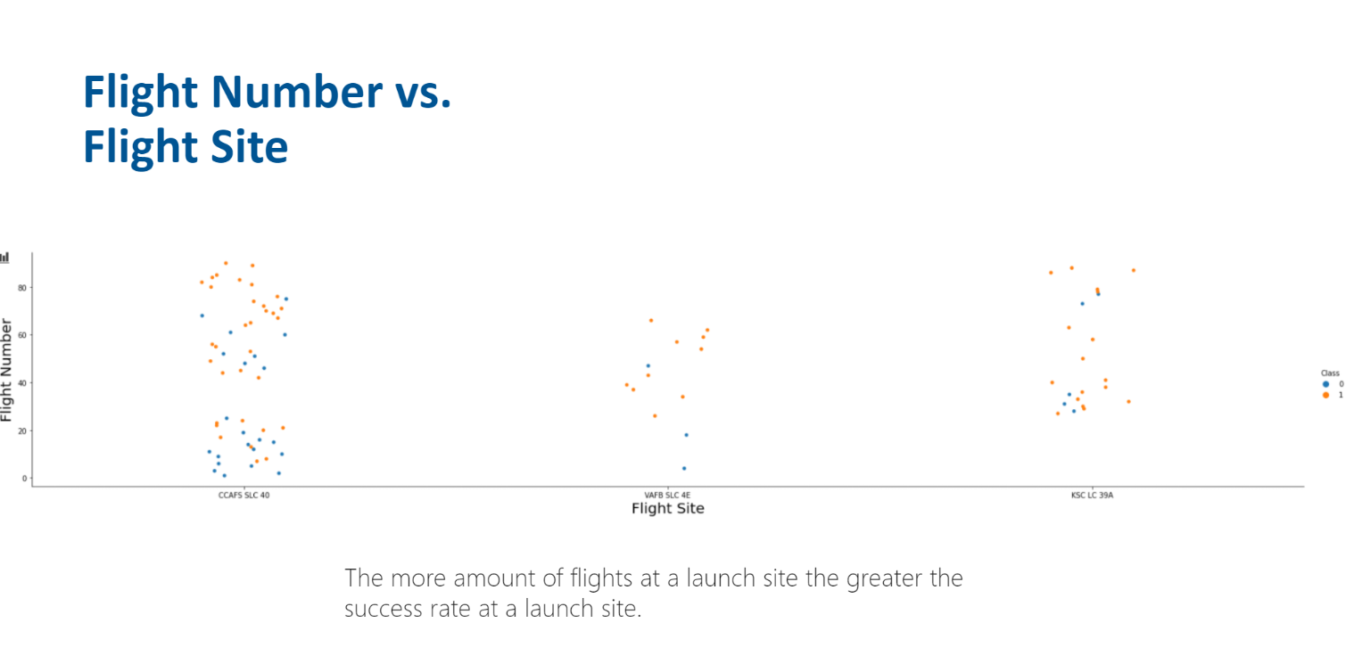

Slide 24
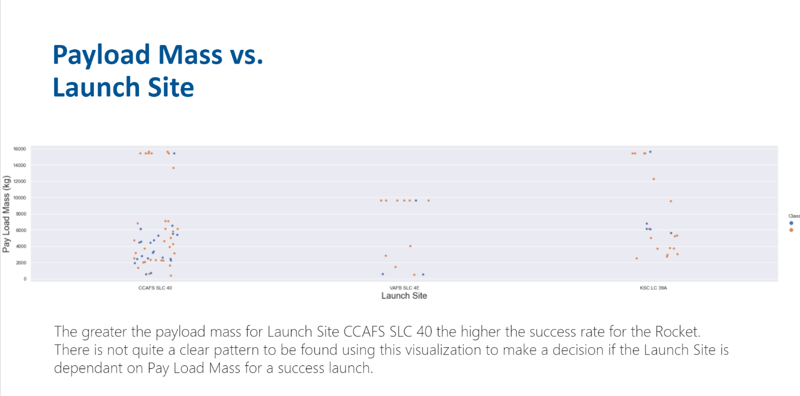

Slide 25
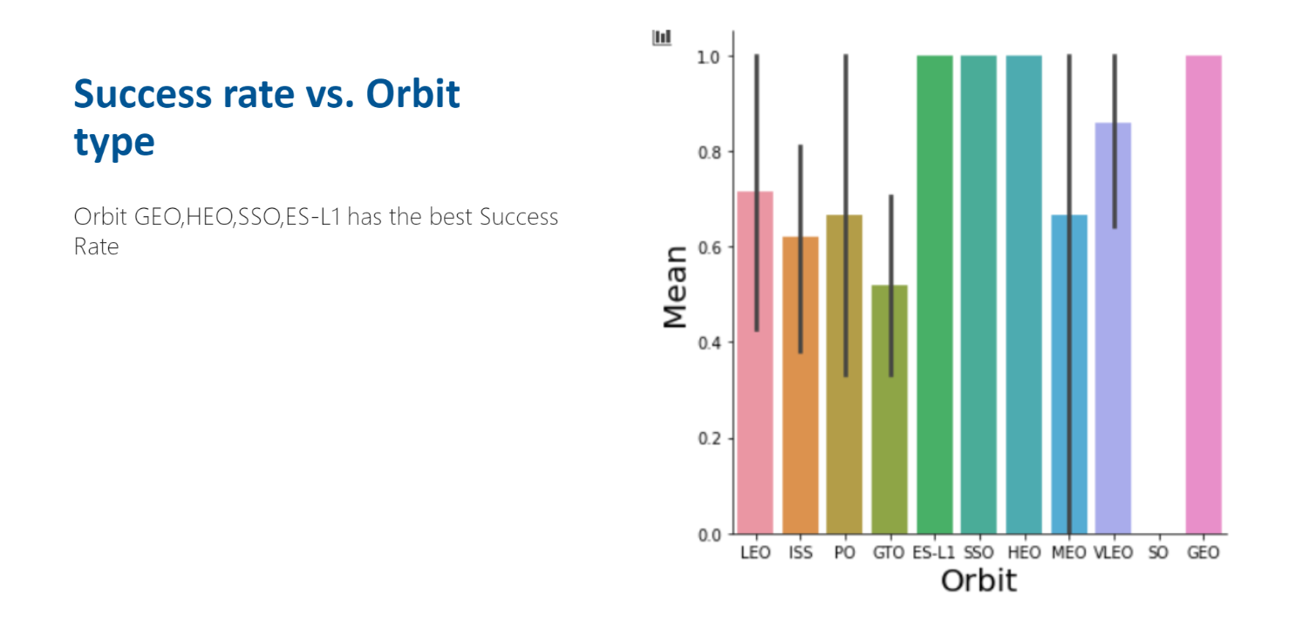

Slide 26
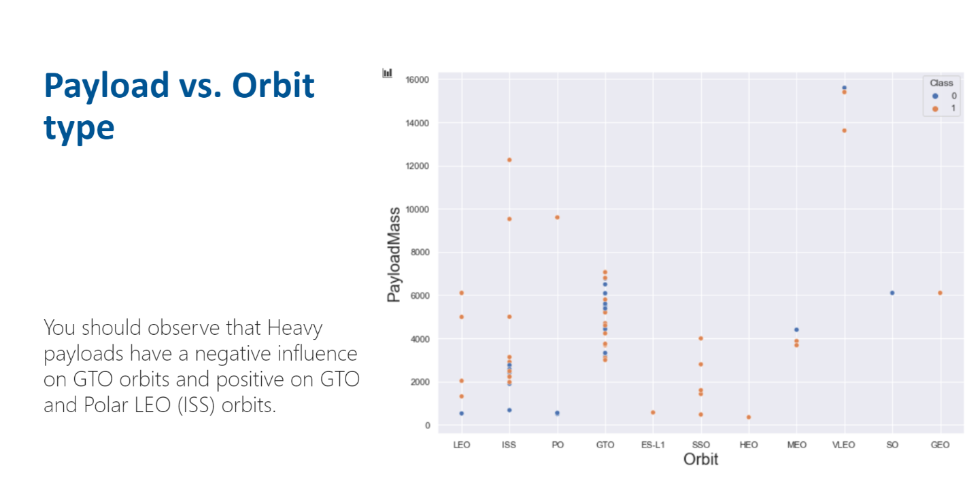

Slide 27
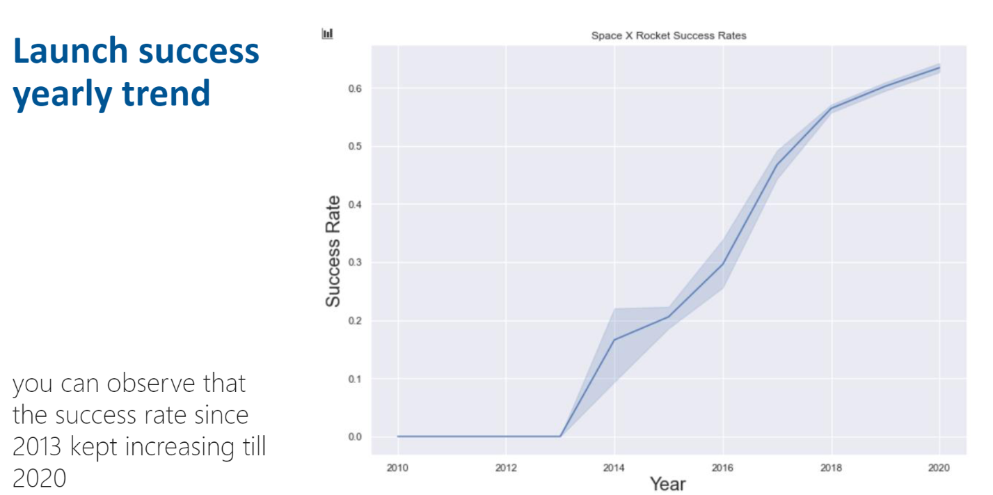

Slide 28

EDA WITH SQL

Slide 29
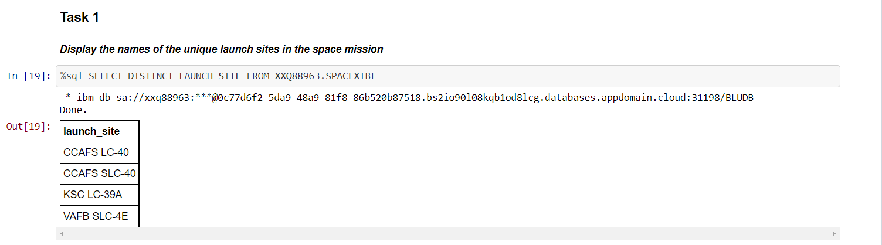
Display the names of the unique launch sites in the space mission

Slide 30
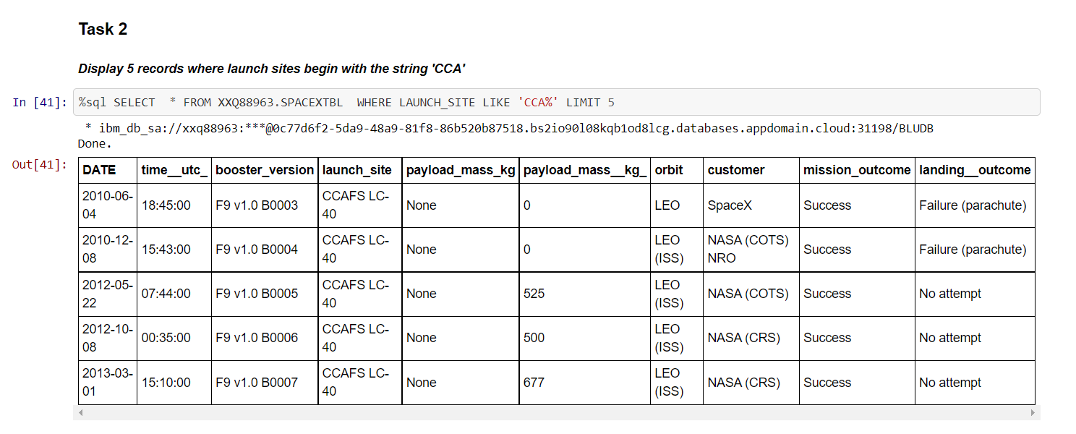
Display 5 records where launch sites begin with the string ‘CCA’

Slide 31
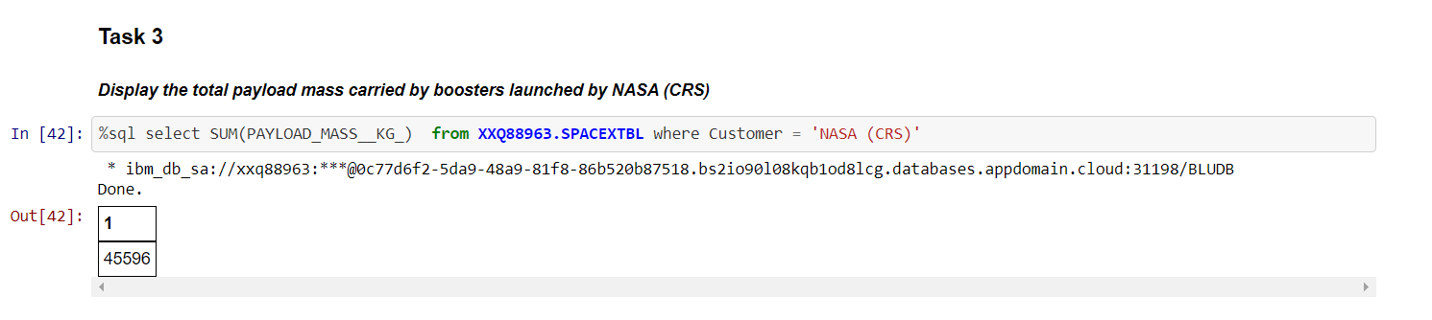
Display the total payload mass carried by boosters launched by NASA (CRS)

Slide 32
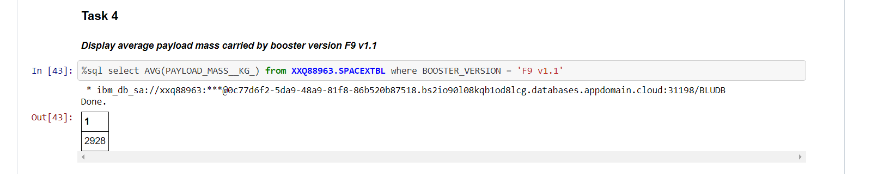
Display average payload mass carried by booster version F9 V1.1

Slide 33
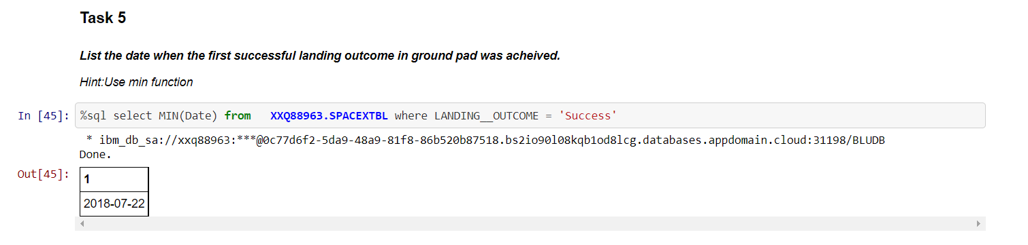
List the date when the first successful landing outcome in ground pad was acheived

Slide 34
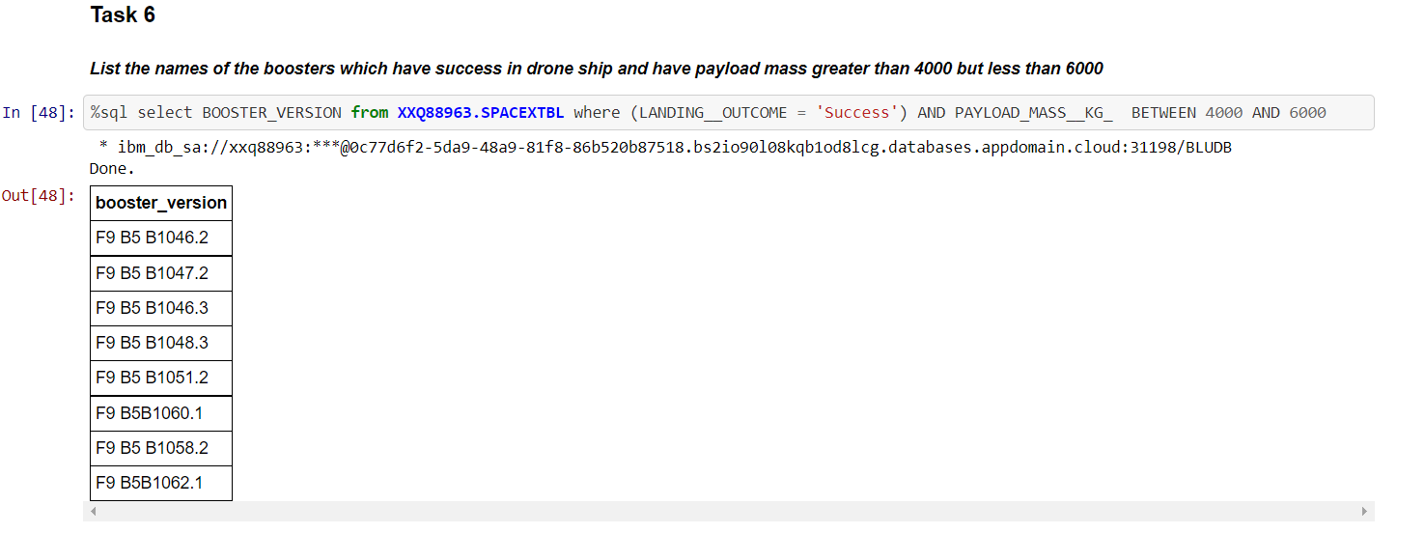
List the names of the boosters which have success in drone ship and have payload mass greate than 4000 but less than 6000

Slide 35
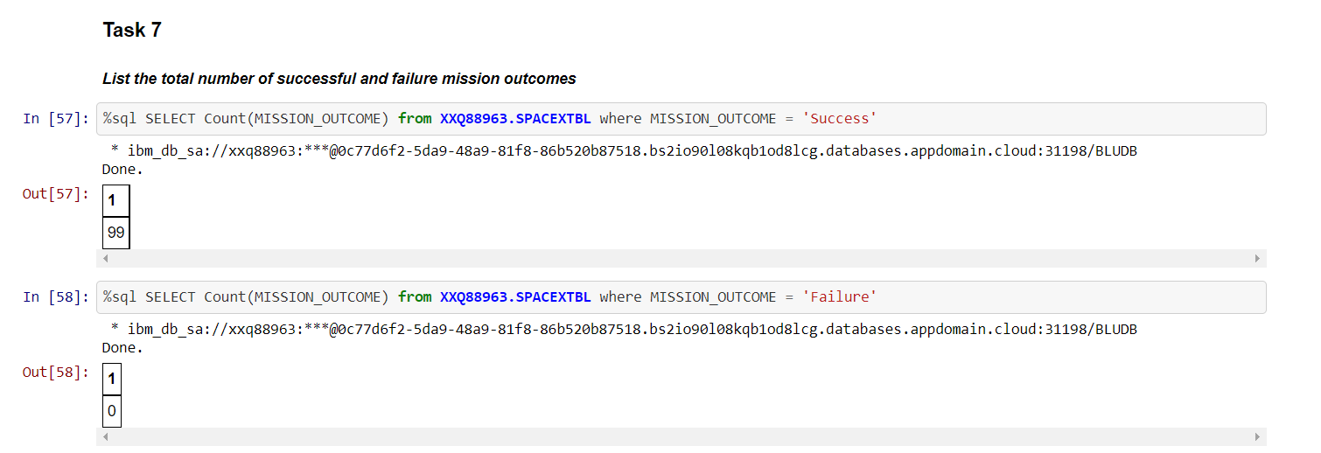
List the total number of successful and failure mission outcomes

Slide 36
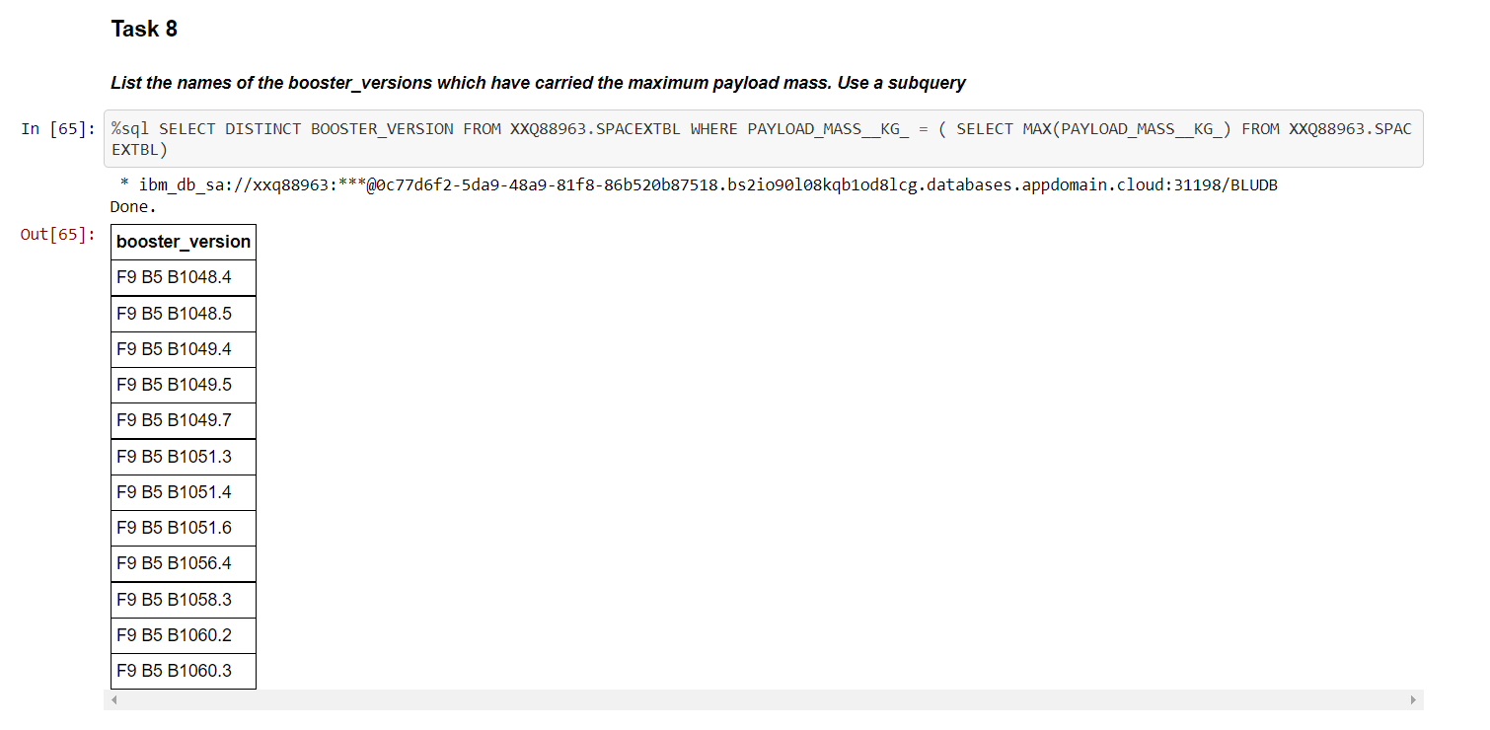
List the names of the booster_version whichhave carried the maximum payloadmass. Use Subquery

Slide 37
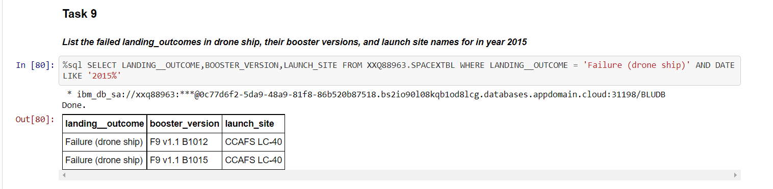
List the failed landing_outcomes in drone ship, their booster versions, and launch site names for in year 2015

Slide 38
Interactive Maps with Folium

Slide 39
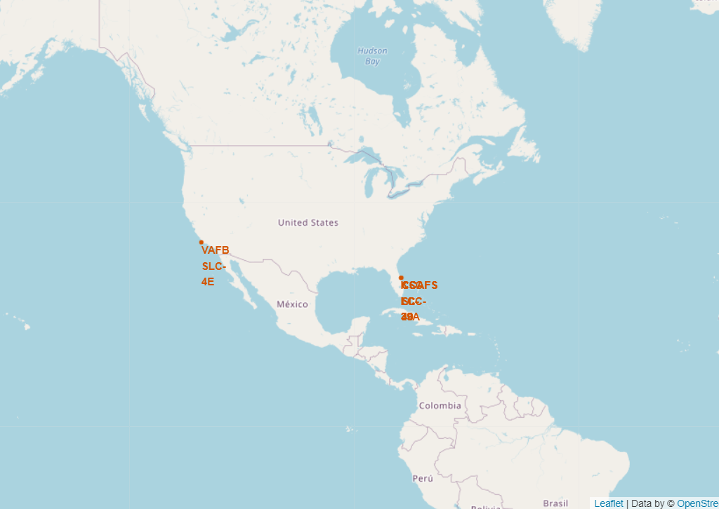
Mark all launch sites on the map
We can see that SpaceX launch sites are both in the United States of America coasts.
Florida and California

Slide 40
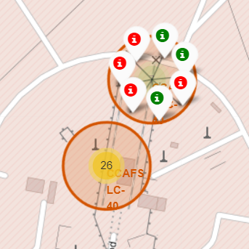
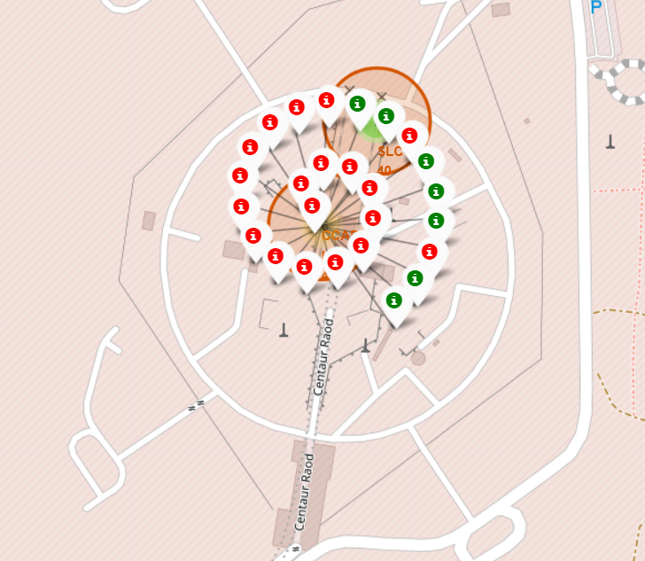
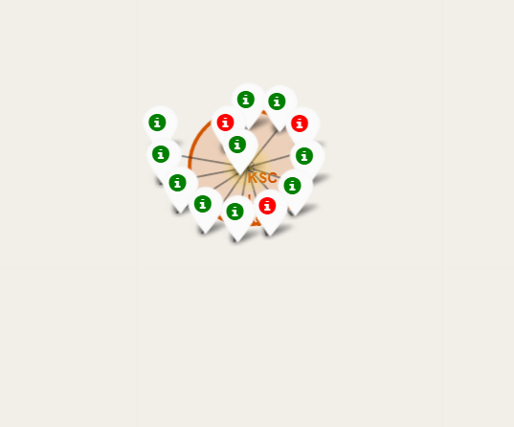
Mark the success/failed launches for each site on the map
Green Markers show successful launches and Red Markers unsuccessful launches
The 2 launching points on the left belong to Florida district
The 1 on the right to California district

Slide 41
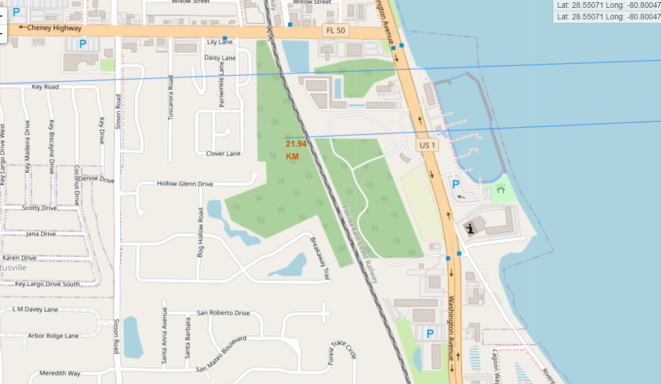
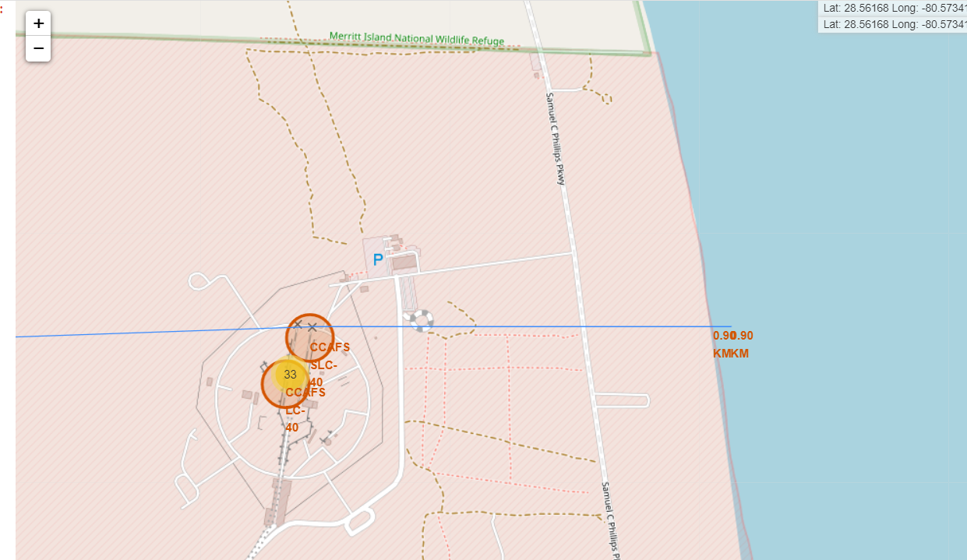
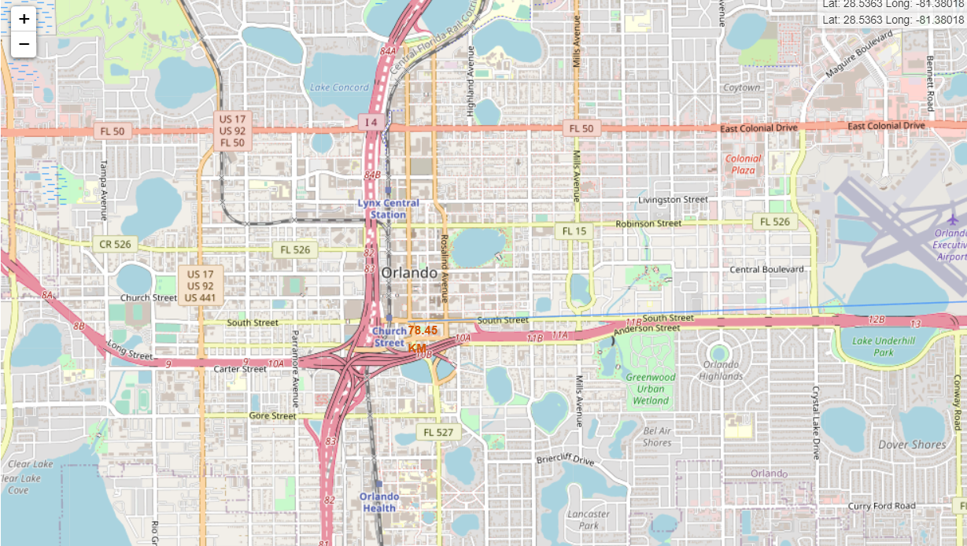
Calculate the distances between a launch site to its proximities
1st Distance to Railway Station
2nd Distance to Coast
3rd Distance to the closest Highway

Slide 42
Predictive Analytics Classification

Slide 43
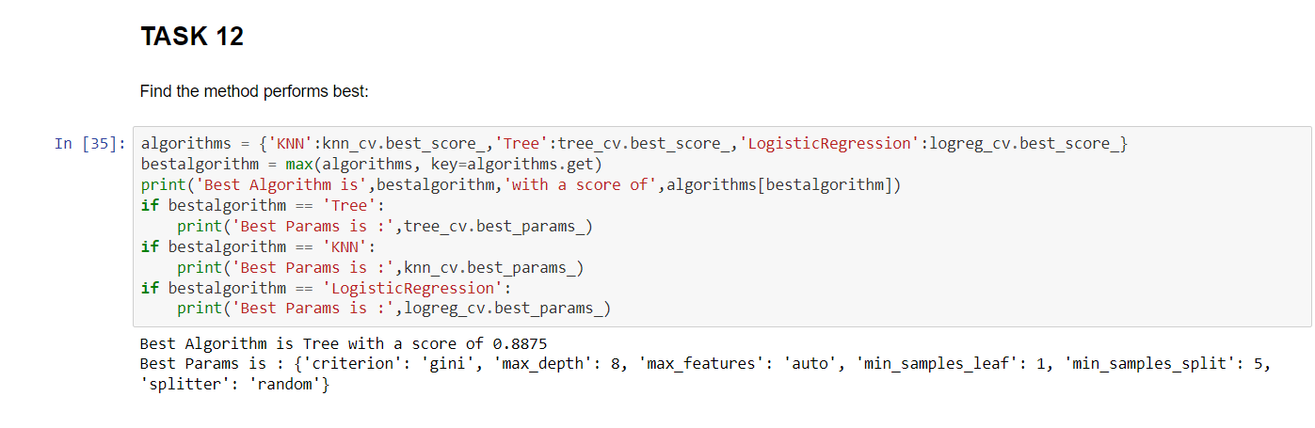
Classification Accuracy using test data
Among the models that were tested, the tree classifier gives the best prediction accuracy ( 0,8875 )
This accuracy is a result of the selection of the best hyperparameters for the tree classifier, as you will see more analytically in the next page

Slide 44
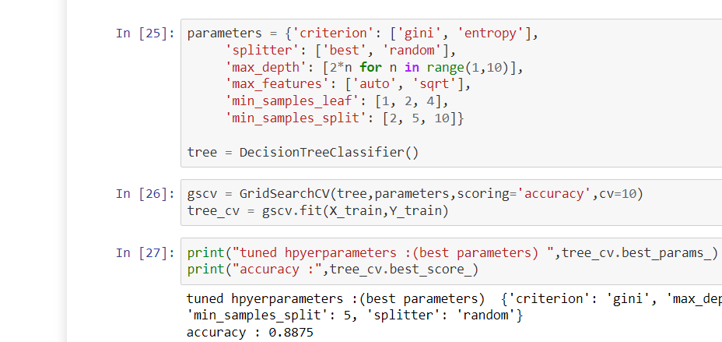
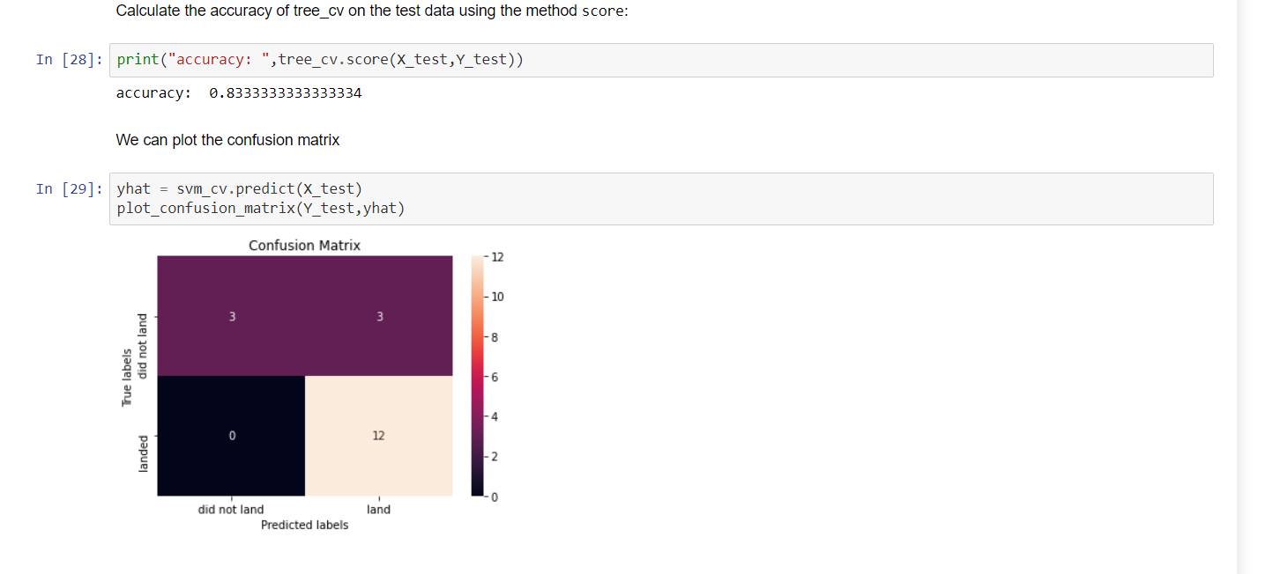
Tree Classifier Execution
Examining the Confusion Matrix, we can see that the Tree can distinguish between different classes.
We see that the major problem is false positives

Slide 45
Conclusion
The Machine Learning algorithm that fits best for the test data is the Tree Classifier
Low weighted payloads perform better than higher payloads
We can see that KSC LC-39A had the most successful launches
We can predict if the first stage will land given the transformed and processed data we have, with accuracy of the prediction to be right 88.75 %
We have to further examine if that percentage has statical significance

Slide 46


